Slide 1
Electrical Properties of Solutions

Slide 2
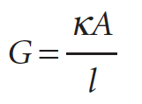
Conductance and Conductivity The fundamental measurement to study the motion of ions
The conductance, G, of a solution is the inverse of its electrical resistance R: G = 1/R.
As resistance is expressed in ohms, Ω, the conductance of a sample is expressed in Ω⁻¹. The reciprocal ohm used to be called the mho, but its official designation is now the siemens, S, and 1 S = 1 Ω⁻¹ = 1 C V⁻¹ s⁻¹.
The conductance of a sample decreases with its length l and increases with its cross-sectional area A.
where κ is the conductivity. With the conductance in siemens (S) and the dimensions in metres (m), it follows that the SI units of κ are siemens per metre (S m⁻¹).

Slide 3
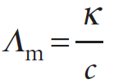
Conductance and Conductivity The fundamental measurement to study the motion of ions
The conductivity of a solution depends on the number of ions present, and it is normal to introduce the molar conductivity, Λ_{m}, which is defined as
where c is the molar concentration of the added electrolyte. The SI unit of molar conductivity is siemens metre-squared per mole (S m² mol⁻¹), and typical values are about 10 mS m² mol⁻¹ (where 1 mS = 10⁻³ S).

Slide 4
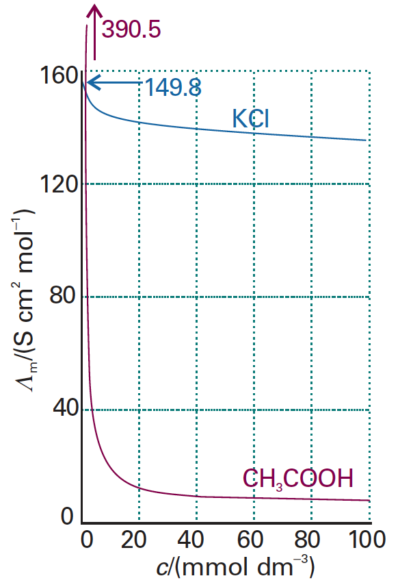
Concentration Dependence of the Molar Conductivities
a typical strong electrolyte (aqueous potassium chloride)
a typical weak electrolyte (aqueous acetic acid).

Slide 5
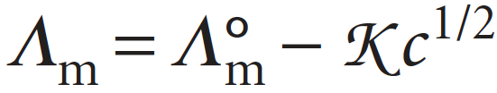
Strong Electrolytes: Kohlrausch’s Law
Strong electrolytes are substances that are virtually fully ionized in solution, and include ionic solids and strong acids. As a result of their complete ionization, the concentration of ions in solution is proportional to the concentration of strong electrolyte added.
Friedrich Kohlrausch showed that at low concentrations the molar conductivities of strong electrolytes vary linearly with the square root of the concentration:
This variation is called Kohlrausch’s law. The constant Λ°_{m} is the limiting molar conductivity, the molar conductivity in the limit of zero concentration (when the ions are effectively infinitely far apart and do not interact with one another). The constant K is found to depend more on the stoichiometry of the electrolyte (that is, whether it is of the form MA, or M₂A, etc.) than on its specific identity.

Slide 6

Kohlrausch’s Law Cont.
Kohlrausch was also able to establish experimentally that Λ°_{m} can be expressed as the sum of contributions from its individual ions. If the limiting molar conductivity of the cations is denoted λ₊ and that of the anions λ₋, then his law of the independent migration of ions states that
Where ν₊ and ν₋ are the numbers of cations and anions per formula unit of electrolyte (for example, ν₊ = ν₋ = 1 for HCl, NaCl, and CuSO₄, but ν₊ = 1,ν₋ = 2 for MgCl₂).

Slide 7
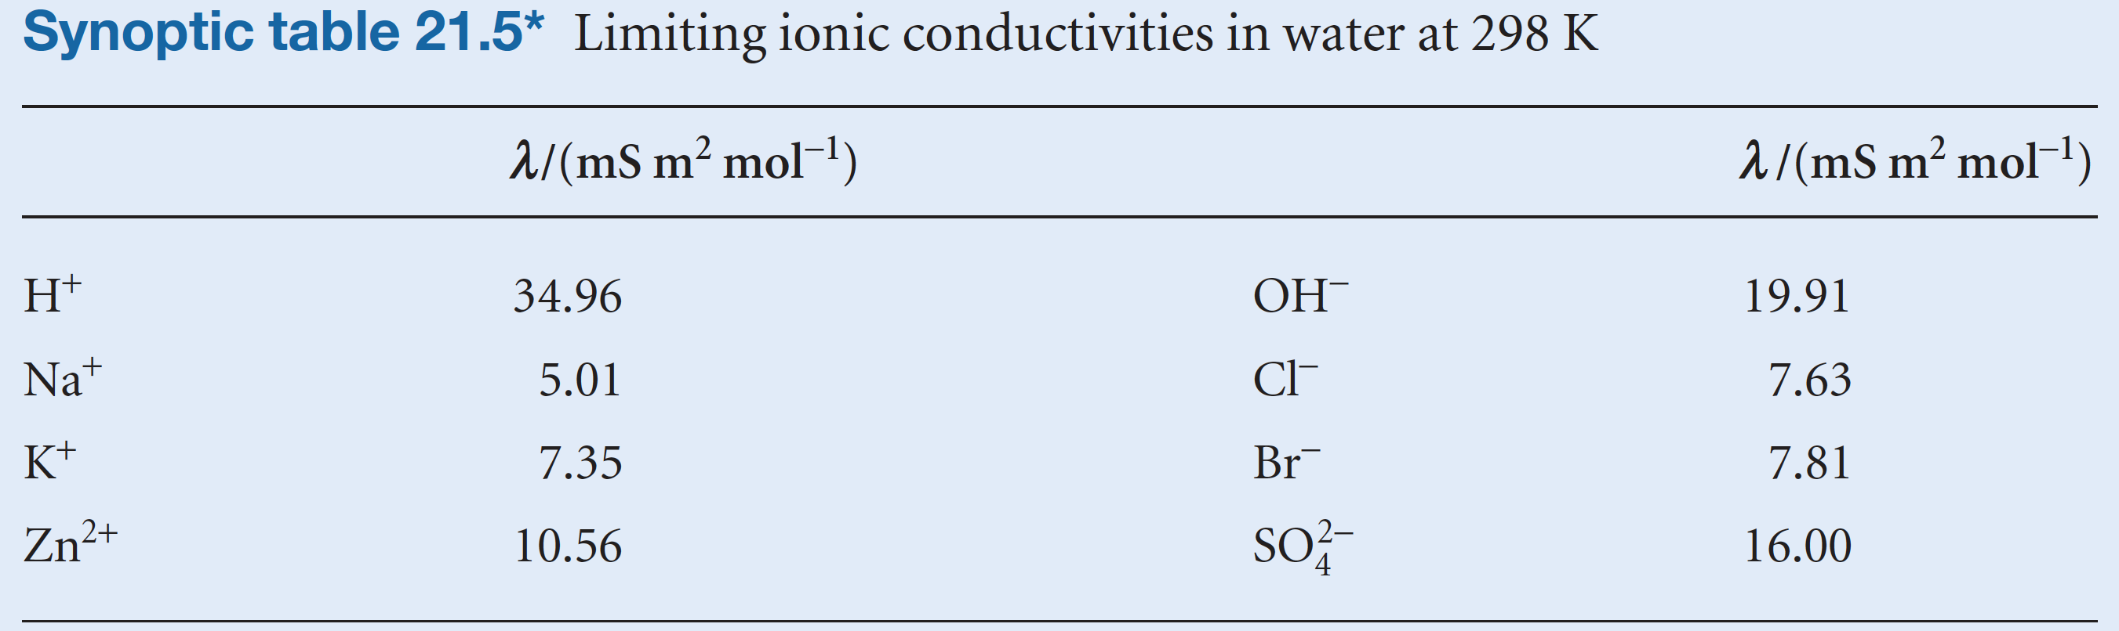
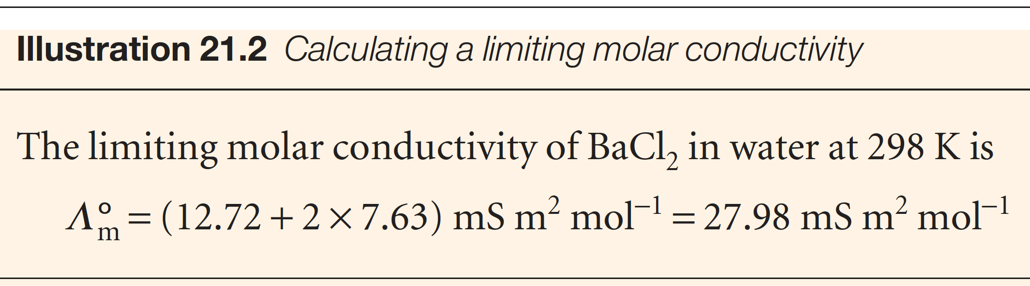
Kohlrausch’s Law Cont.

Slide 8
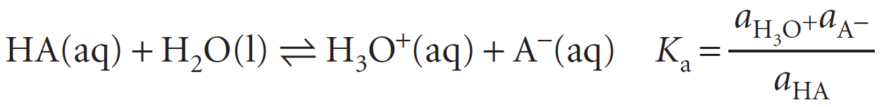
Weak Electrolytes
Weak electrolytes are not fully ionized in solution. They include weak Brønsted acids and bases, such as CH₃COOH and NH₃. The marked concentration dependence of their molar conductivities arises from the displacement of the equilibrium towards products at low molar concentrations.
The conductivity depends on the number of ions in the solution, and therefore on the degree of ionization,α, of the electrolyte; when referring to weak acids, we speak instead of the degree of deprotonation. It is defined so that, for the acid HA at a molar concentration c, at equilibrium

Slide 9
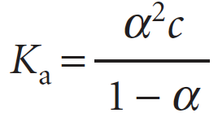
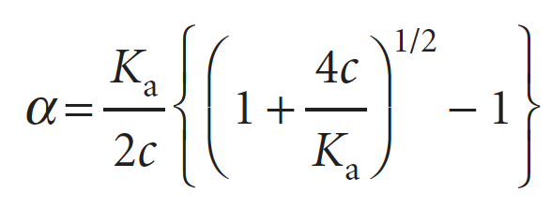
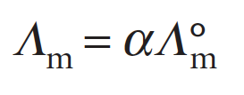
Weak Electrolytes Cont.
If we ignore activity coefficients, the acidity constant, K_{a}, is approximately
from which it follows that
The acid is fully deprotonated at infinite dilution, and its molar conductivity is then Λ°_{m}. Because only a fraction α is actually present as ions in the actual solution, the measured molar conductivity Λ_{m} is given by

Slide 10
Weak Electrolytes Cont.
Once we know K_{a}, we can use the eqns to predict the concentration dependence of the molar conductivity.

Slide 11
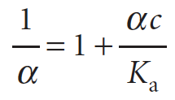
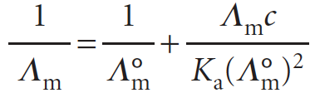
Weak Electrolytes Cont.
Again, we can use the concentration dependence of Λ_{m} in measurements of the limiting molar conductance.
We’ve already seen that,
By rearranging this equation we get,
Substituting we get Ostwald’s dilution law:

Slide 12
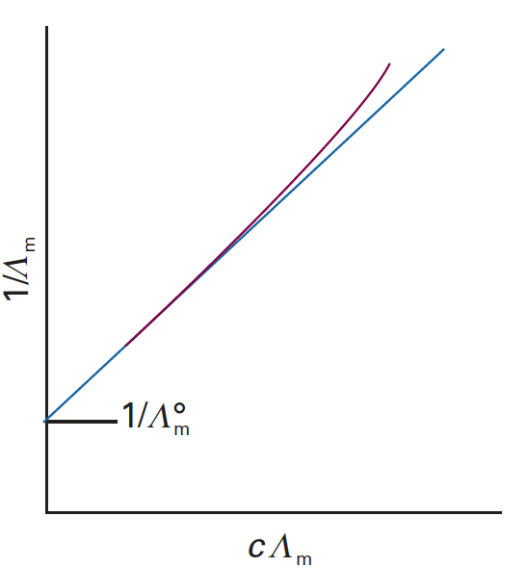
Weak Electrolytes:
Ostwald’s Dilution Law
This equation implies that, if 1/Λ_{m} is plotted against cΛ_{m}, then the intercept at c = 0
will be 1/Λ°_{m}
Figure. The graph used to determine the limiting value of the molar conductivity of a solution by extrapolation to zero concentration.

Slide 13
